Slide 1
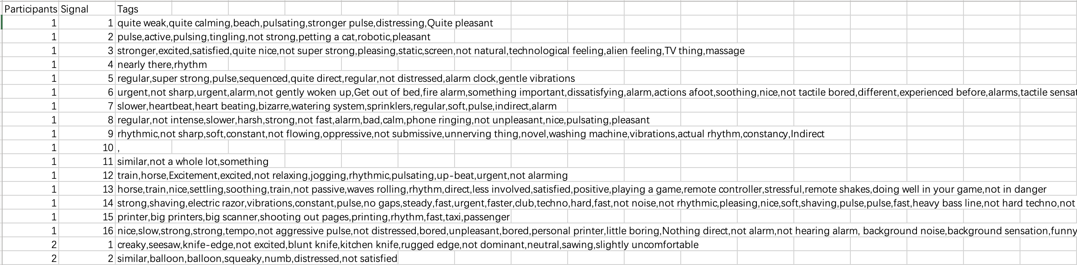
Datasets format
P01.txt to P12.txt contain the descriptions from the 12 participants. Each line has the description for a different signal (e.g., line 1 includes the description for signal 1). 32 signals in total.
Manual_dataset.csv contains the selected phrases (“tags”) from each participant’s description for each signal. Note that if a phrase repeats in the description, all occurrences are considered matches.

Slide 2
Step1: Use GPT-3.5 with fine-tuning method to extract sensational, emotional, metaphoric keywords
Training prompt format:
{"messages":[
{"role": "system", "content": "You are a helpful linguistic assistant. Extract keywords including sensational, emotional, metaphoric, and usage examples from the corresponding texts below: 1. You need to first understand the meaning of the sentence before selection. 2. Remain the negative or positive meaning of the sentences. 3. Only select ADJ and NOUN keywords. 4. Must Remove words \"emotional\", \"sensational\", \"emotion\", \"sensation\", \"feeling\", and their derivatives."},
{"role": "user", "content": ptext_df['Text'].iloc[i] },
{"role": "assistant", "content": cleaned_manual_df['Tags'].iloc[i]} ] }

Slide 3
Step1: Use GPT-3.5 with fine-tuning method to extract sensational, emotional, metaphoric keywords
Divide the data into training and testing sets, with a ratio of 3:7
Testing prompt format: (with no ”assistant” part)
{"messages": [
{"role": "system", "content": "Extract keywords including sensational, emotional, metaphoric, and usage examples from the corresponding texts below."},
{"role": "user", "content": "This feels a little bit more intrusive again. I feel like we're back to the slightly more aggressive ones in a way like it feels a little bit more aggressive. I keep thinking of the sticker again. The sticker stuff, it feels like that. It feels like I expect to take my finger off, and there would be something on my finger that was in the way. It doesn't feel painful or annoying or anything. It's just like there's some kind of obstruction."}],
"Participants": 3,
"Signal": 12}

Slide 4
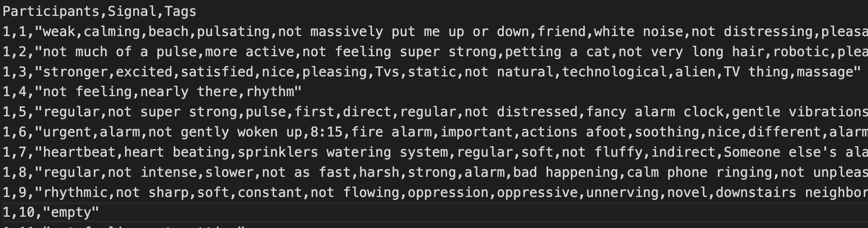
Step1: Use GPT-3.5 with fine-tuning method to extract sensational, emotional, metaphoric keywords
Obtain responses from the model:
response = completion.choices[0].message["content"]
Add Participants, Signal, Tags columns and save to fine_tune_res.csv

Slide 5
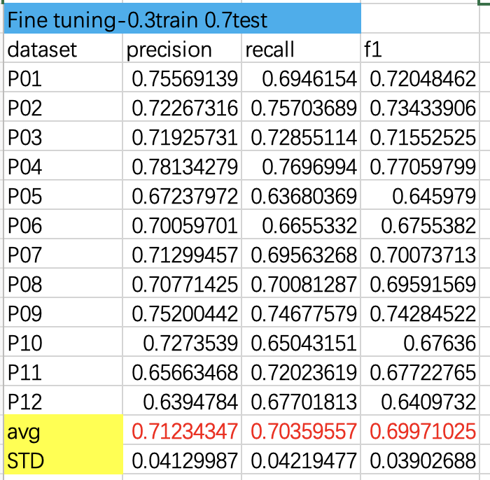
Step2: Calculate strict precision, recall and f1 score of each participants

Slide 6
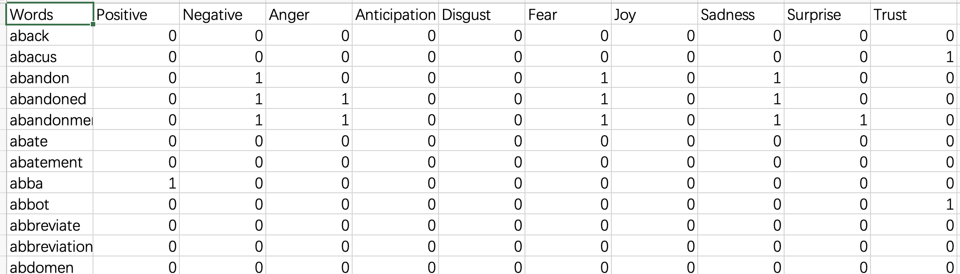
Step3: Keywords further selection --words
Divide into single Words and Phrases
For single Word and “not” word: NRC-Emotion-Lexicon
https://saifmohammad.com/WebPages/NRC-Emotion-Lexicon.htm

Slide 7
Step3: Keywords further selection --words
Define the emotional attribute threshold a=0.25:
if avg_pos>a and avg_pos>avg_neg: “positive”
elif avg_neg>a and avg_neg>avg_pos: ”negative”
else: “neutral”
For “not”+word, if the word’s avg_pos>=avg_neg, the whole is “negative”; else if the word’s avg_neg>avg_pos, the whole is “positive”
Only consider positive and negative attributes, using static word embeddings

Slide 8
Step3: Keywords further selection --words
Positive, Anticipation, Joy, Surprise, Trust—”Positive attribute”
Negative, Anger, Disgust, Fear, Sadness—”Negative attribute”
If num(pos attribute)>num(neg attribute) -> ”positive”
If num(pos attribute)<num(neg attribute) -> ”negative”
If num(pos attribute)=num(neg attribute) -> ”neutral”

Slide 9
Step3: Keywords further selection --words
Convert all nouns to adjectives, and change comparative and superlative forms back to their base form.
A small number of words were not successfully converted.
WordNetLemmatizer.lemmatize():
Comparative and superlative -> base form
wordnet.synsets.lemmas.derivationally_related_forms():
nouns -> adjectives
Convert uppercase to lowercase. Remove all duplicate words

Slide 10
Step3: Keywords further selection --words
For “not” words, find their antonyms using wordnet.antonyms(), if not find, keep the original form (for GloVe and Word2Vec or add ”un” + words (for FastText).
Before:
Positive:183 Negative: 218 Neutral: 987
After:
Positive: 96 Negative: 115
Notes:
203 88 113

Slide 11
Step3: Keywords further selection --phrases
Keep original uppercase and lowercase. (“Apple” and “apple”)
Remove all duplicate phrases
Before: 714
After: 681

Slide 12
Step4: word embedding and hierarchical clustering --words
1. GloVe
Pre-train model: glove.840B.300d, based on Common Crawl
https://nlp.stanford.edu/projects/glove/
2. Word2Vec
Pre-train model: GoogleNews-vectors-negative300.bin:
https://code.google.com/archive/p/word2vec/
3. FastText
Pre-train model: wiki.en.bin
https://fasttext.cc/docs/en/crawl-vectors.html

Slide 13
Step4: word embedding and hierarchical clustering --phrases
1. BERT
Pretrain model: Bert-base-cased
https://huggingface.co/bert-base-cased
2. RoBERTa
Pretrain model: Roberta base
https://huggingface.co/roberta-base
3. SpanBert
Pretrain model: spanbert-base-cased
https://huggingface.co/SpanBERT/spanbert-base-cased
Notes:
span-level

Slide 14
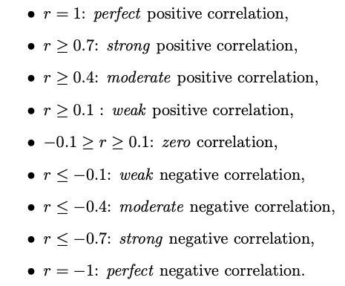
Step 5: Correlation between signal patterns and Clusters:
n_clusters | GloVe | Word2Vec | FastText
positive | 12 | 12 | 12
negative | 13 | 13 | 13
n_clusters | Bert | Roberta | SpanBert
phrases | 31 | 31 | 31
Seven signal patterns: mean_amplitude, rms, pulse_count, std_pulse_dist, zero_count, mean_onset_strength, spectral_centroid

Slide 15
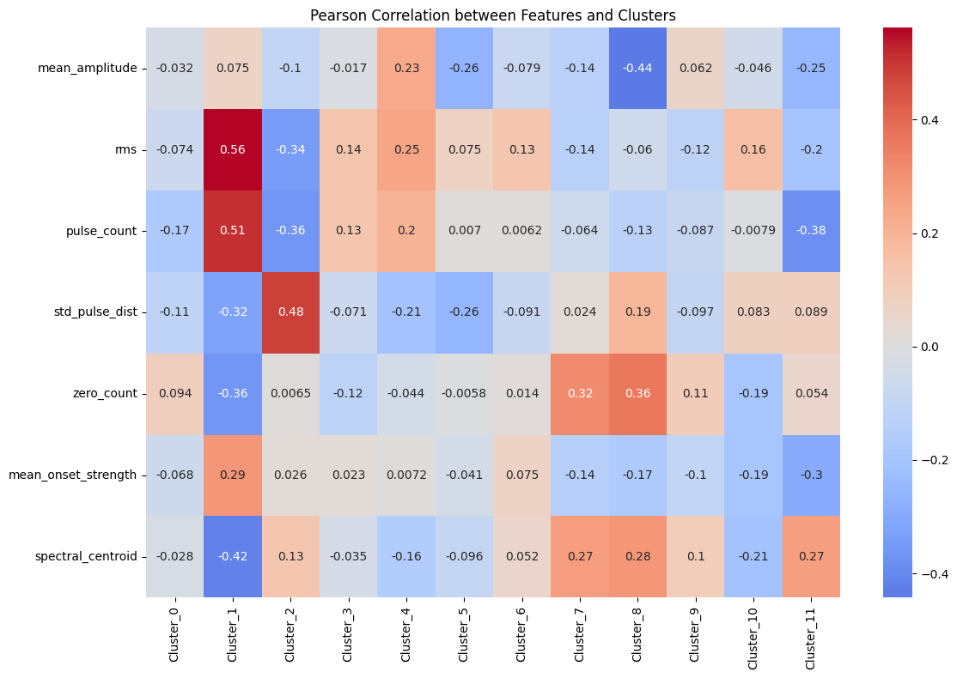
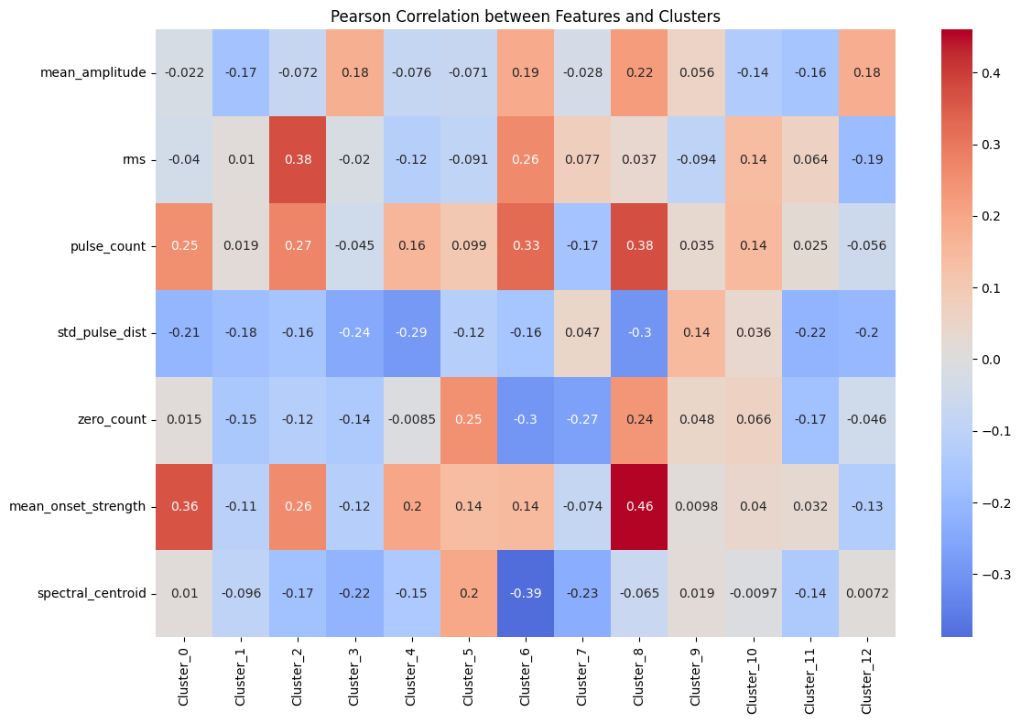
GloVe
Positive
Negative

Slide 16
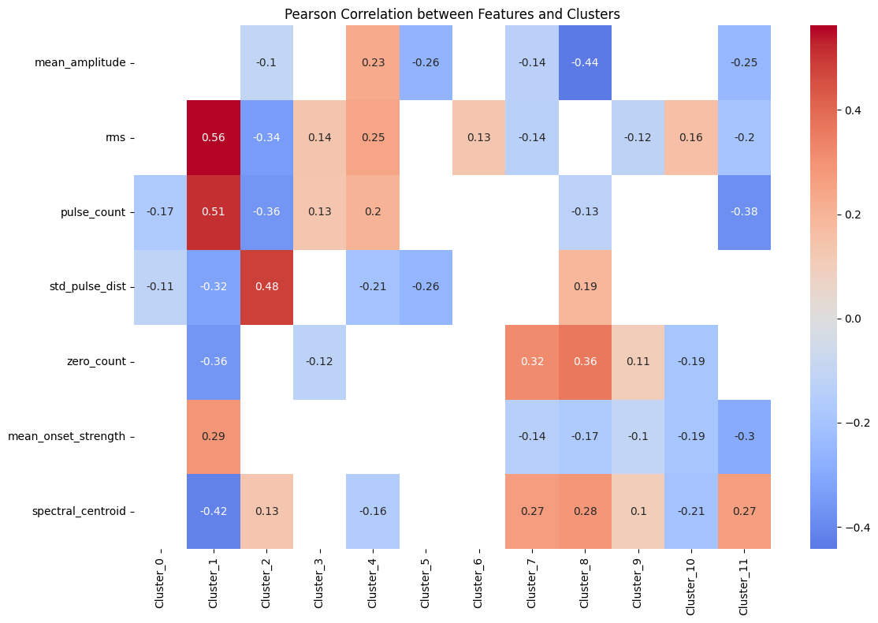
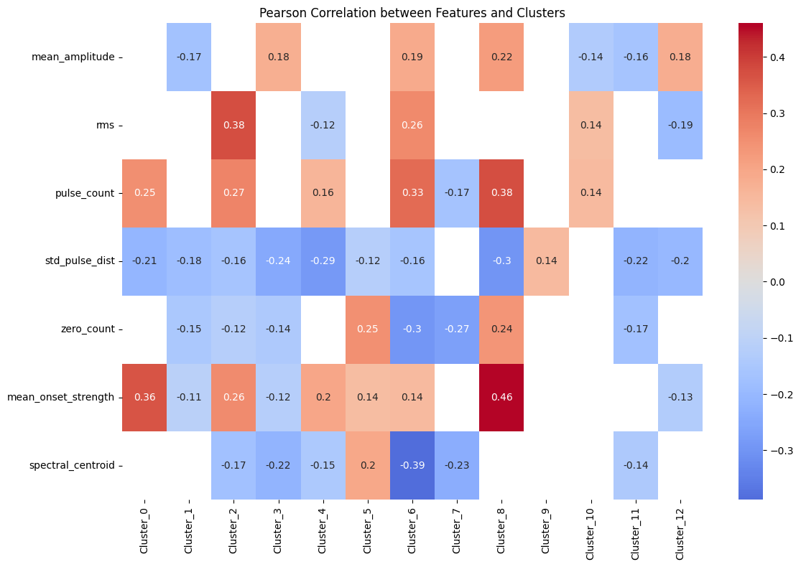
GloVe
Positive
Negative

Slide 17
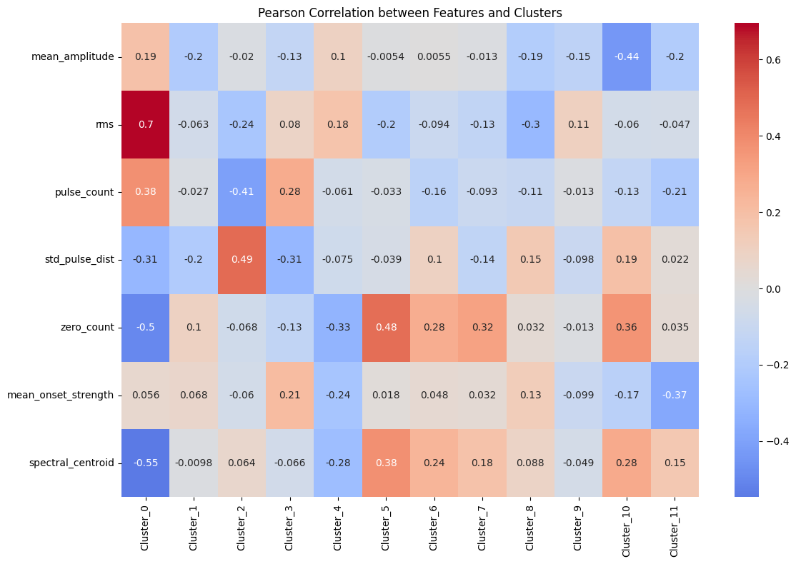
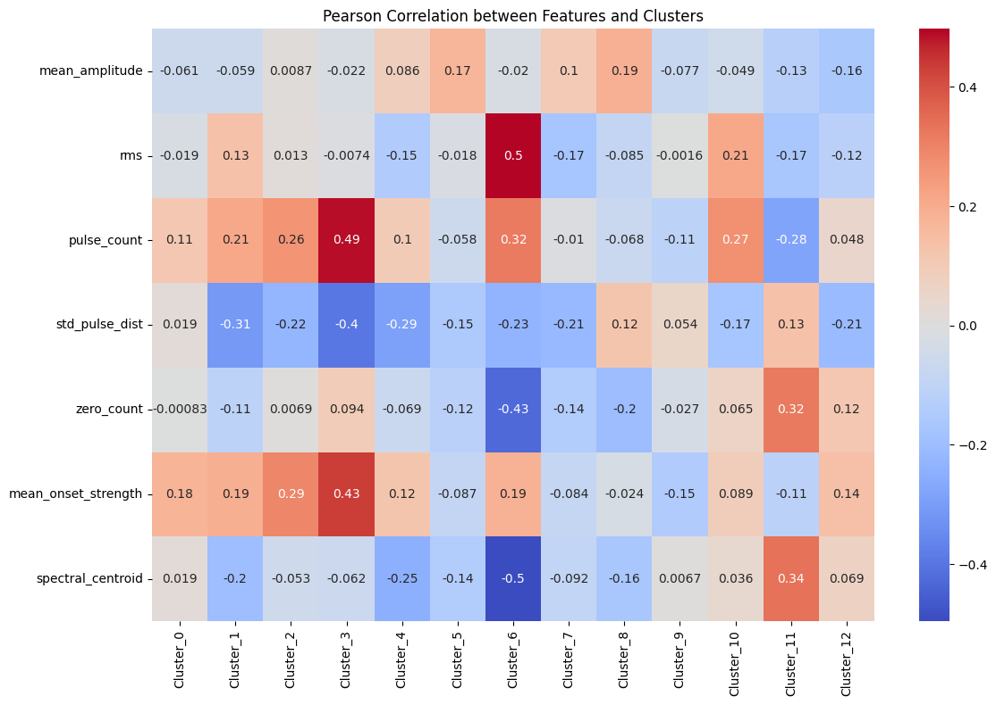
Word2Vec
Positive
Negative

Slide 18
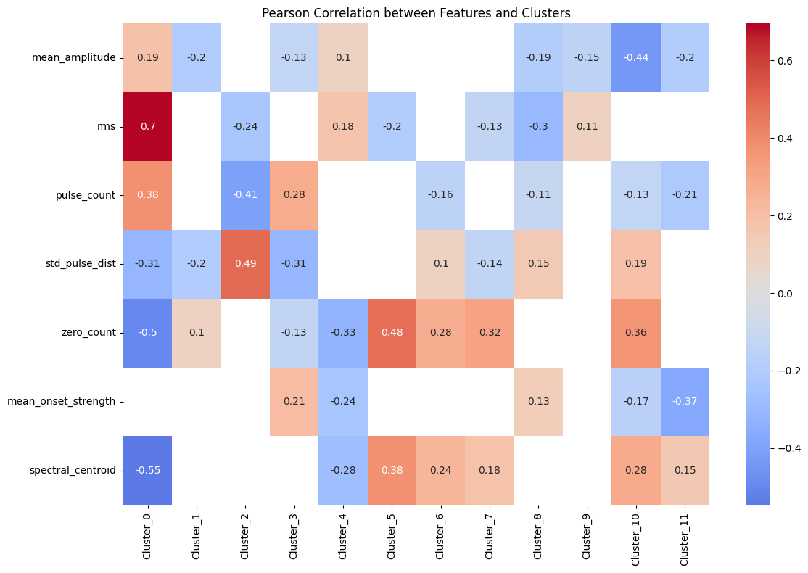
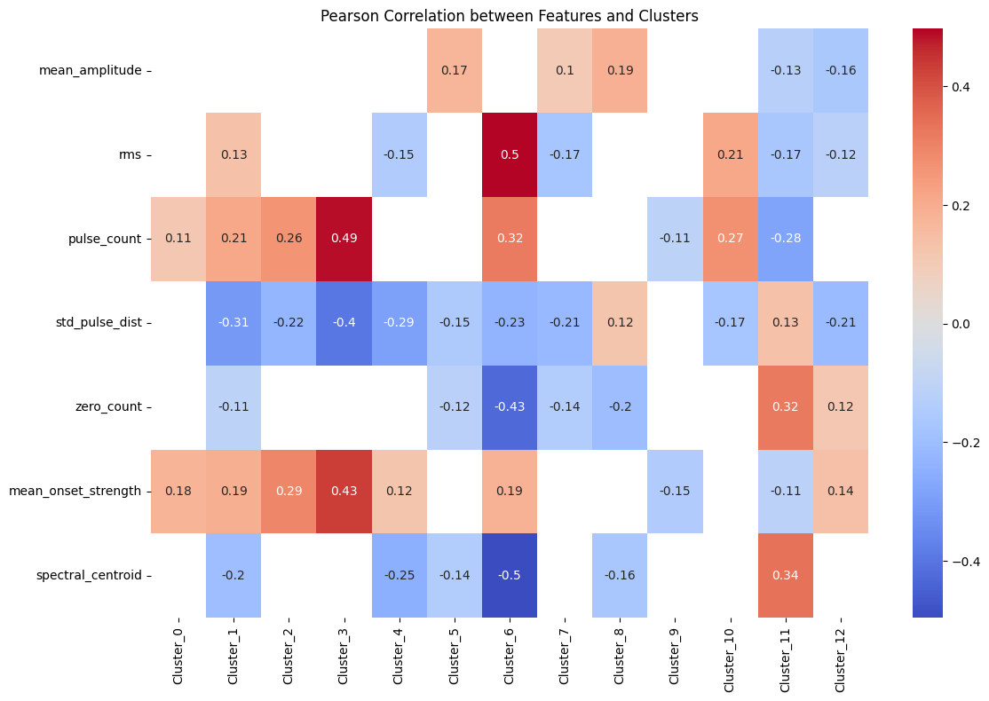
Word2Vec
Positive
Negative

Slide 19
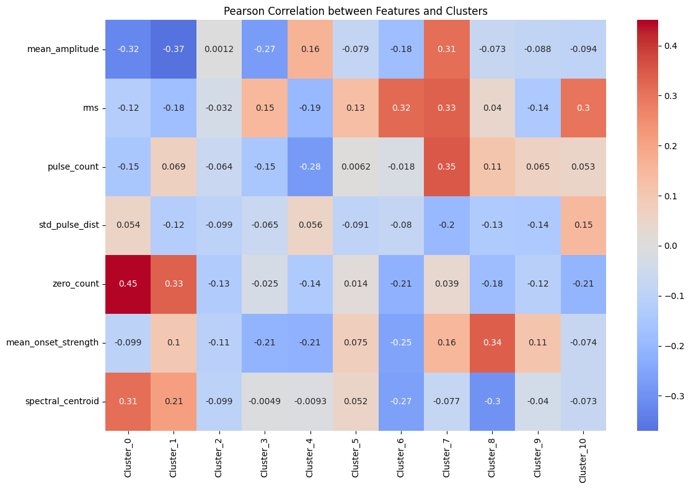
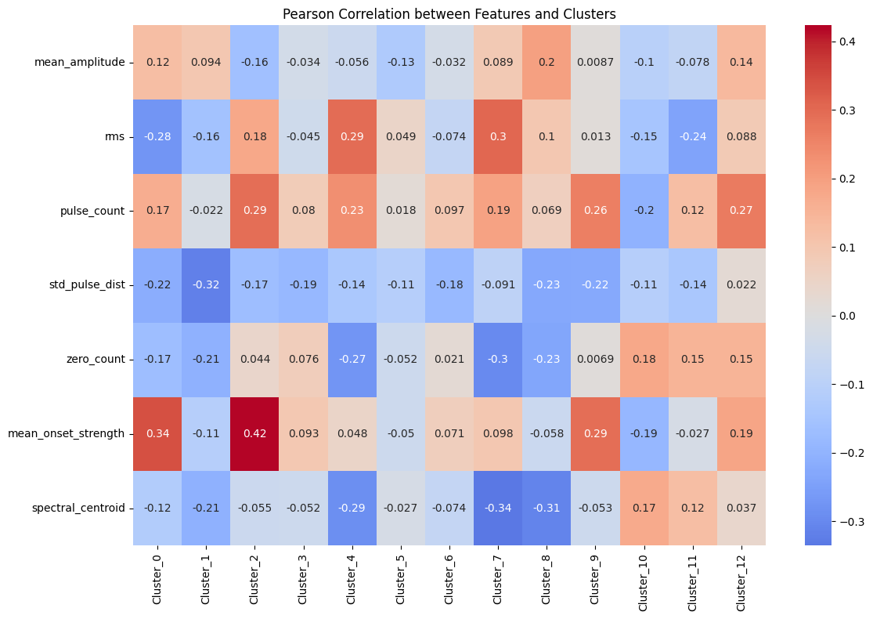
FastText
Positive
Negative

Slide 20
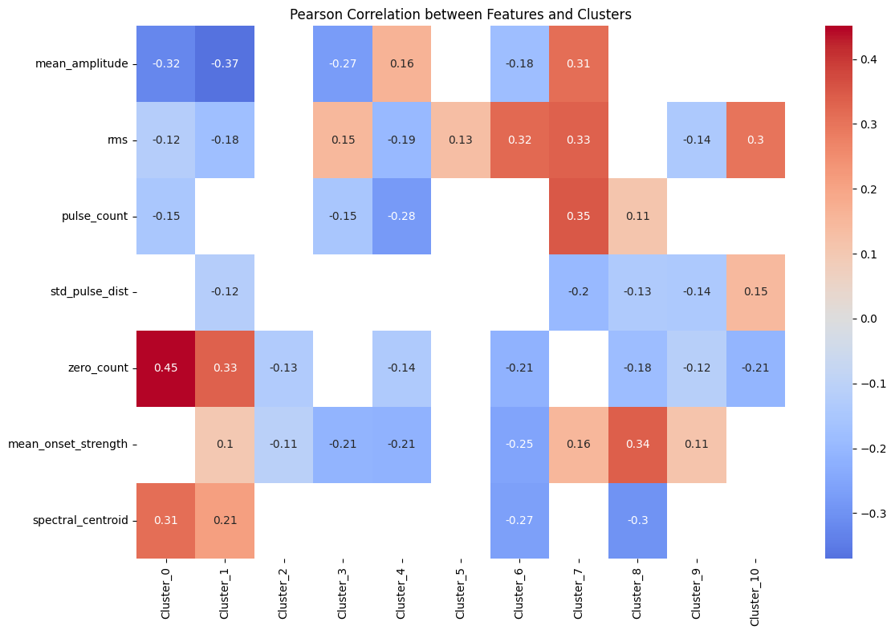
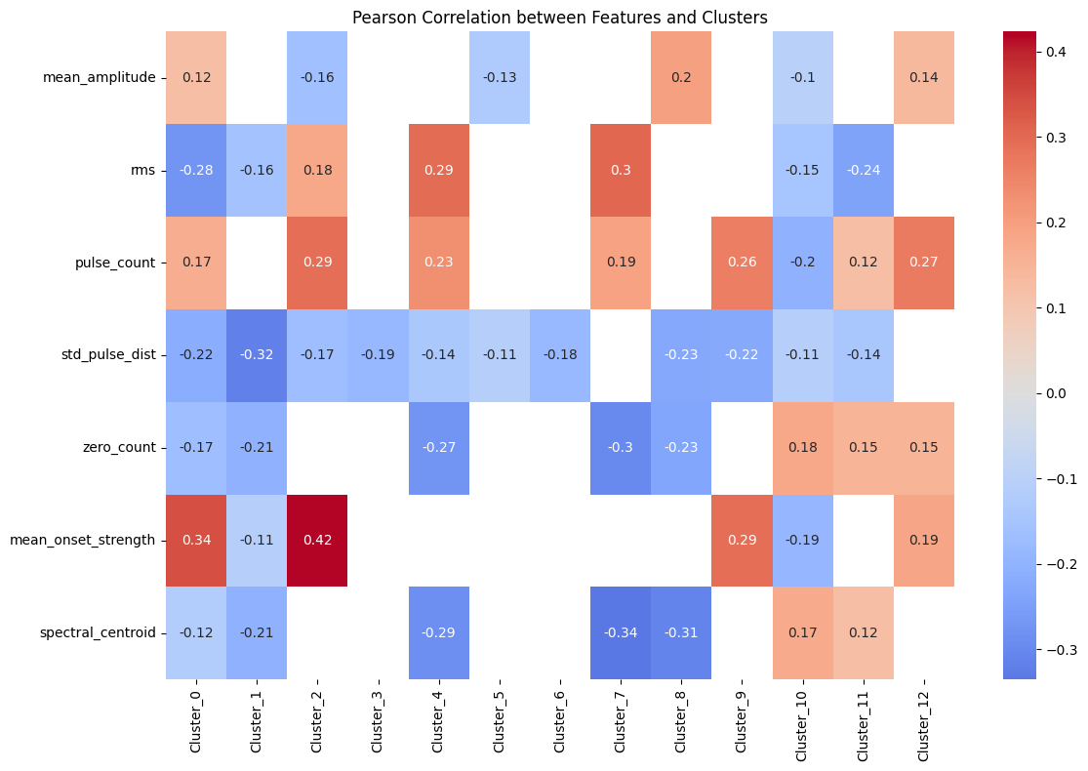
FastText
Positive
Negative

Slide 21
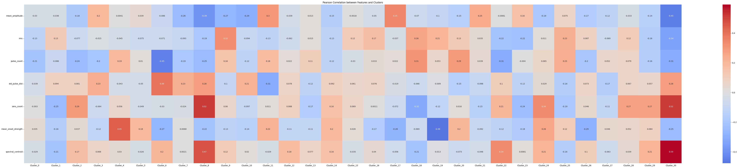
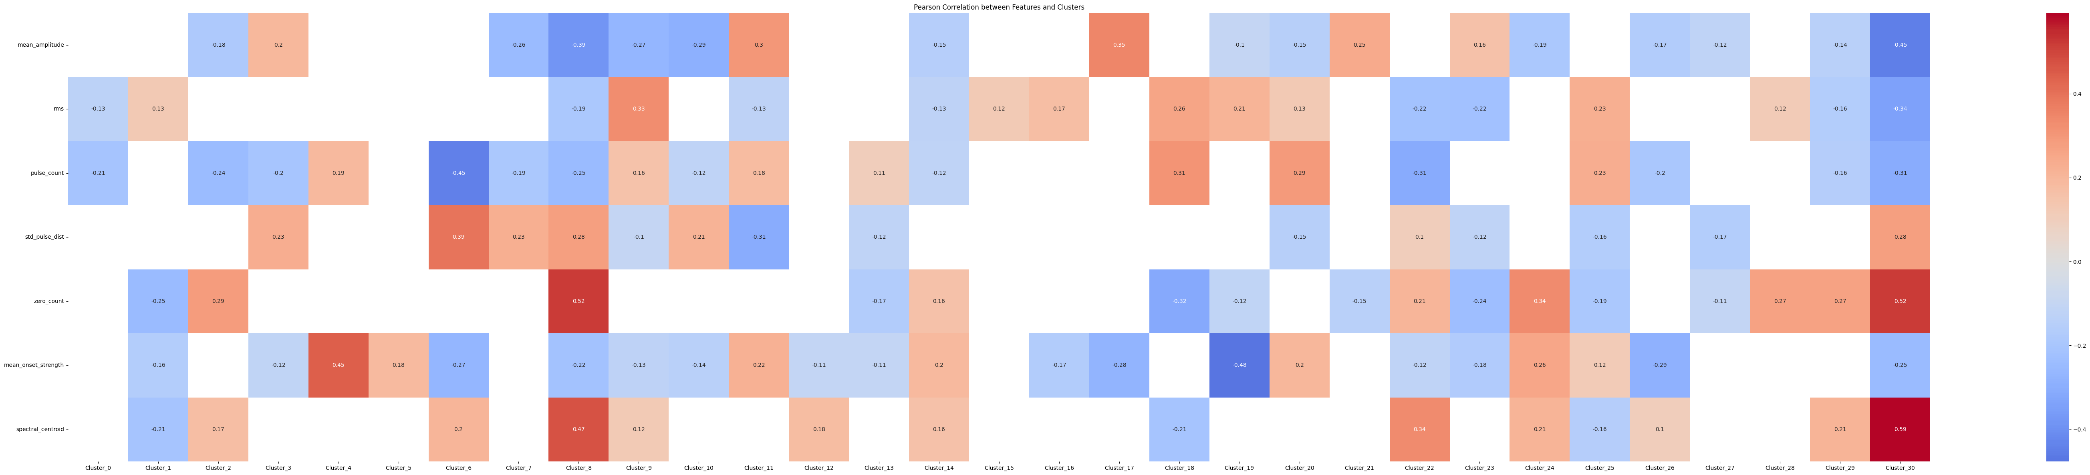
Bert

Slide 22
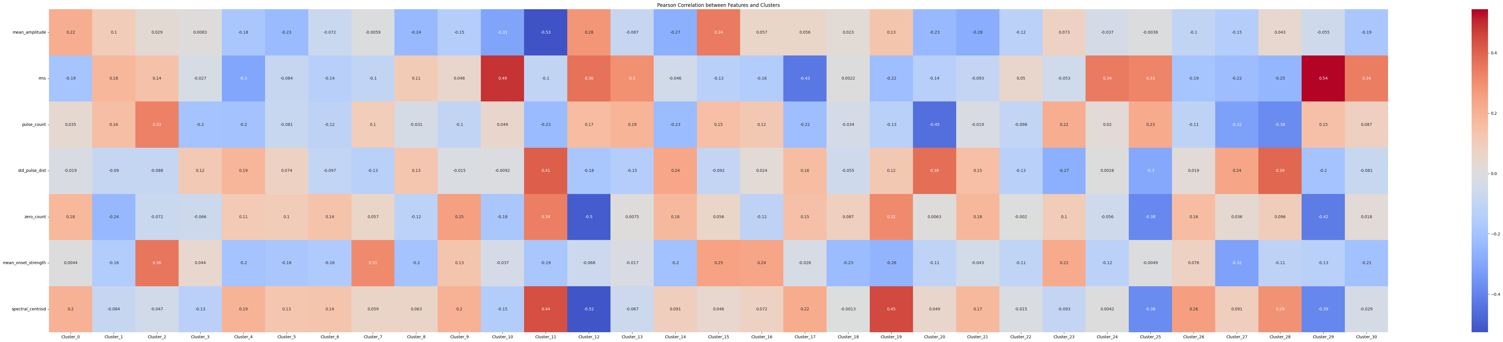
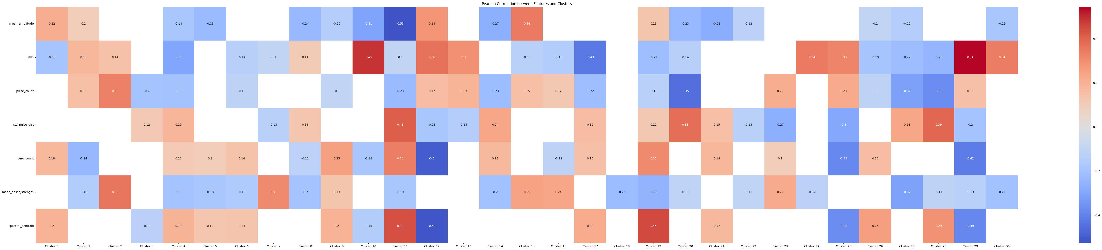
Roberta

Slide 23
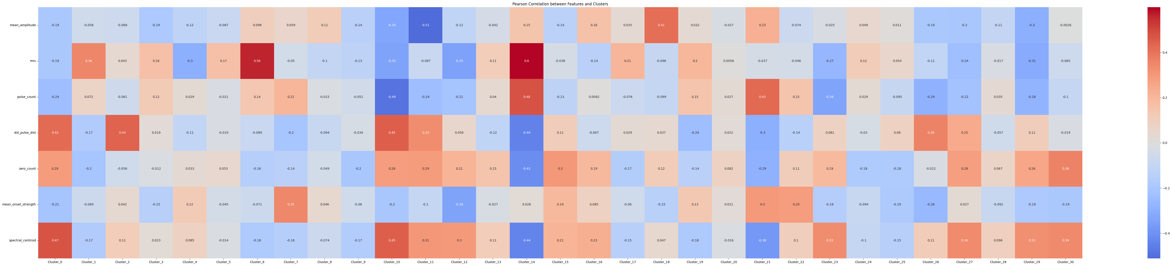
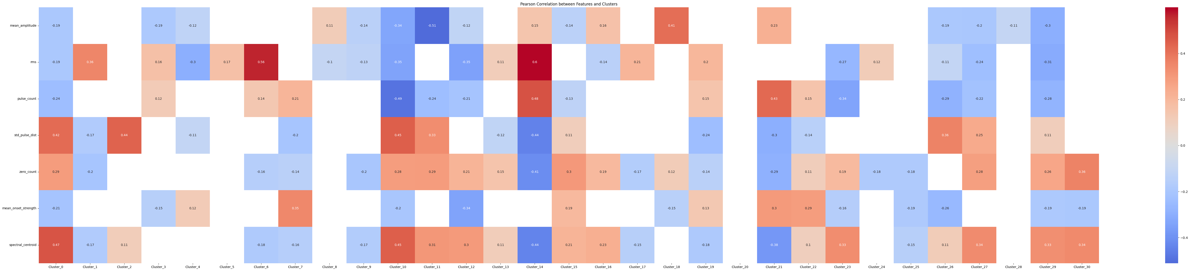
SpanBert

Slide 24
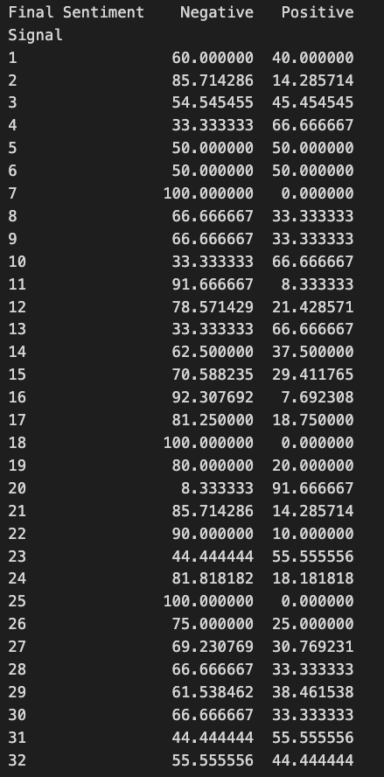
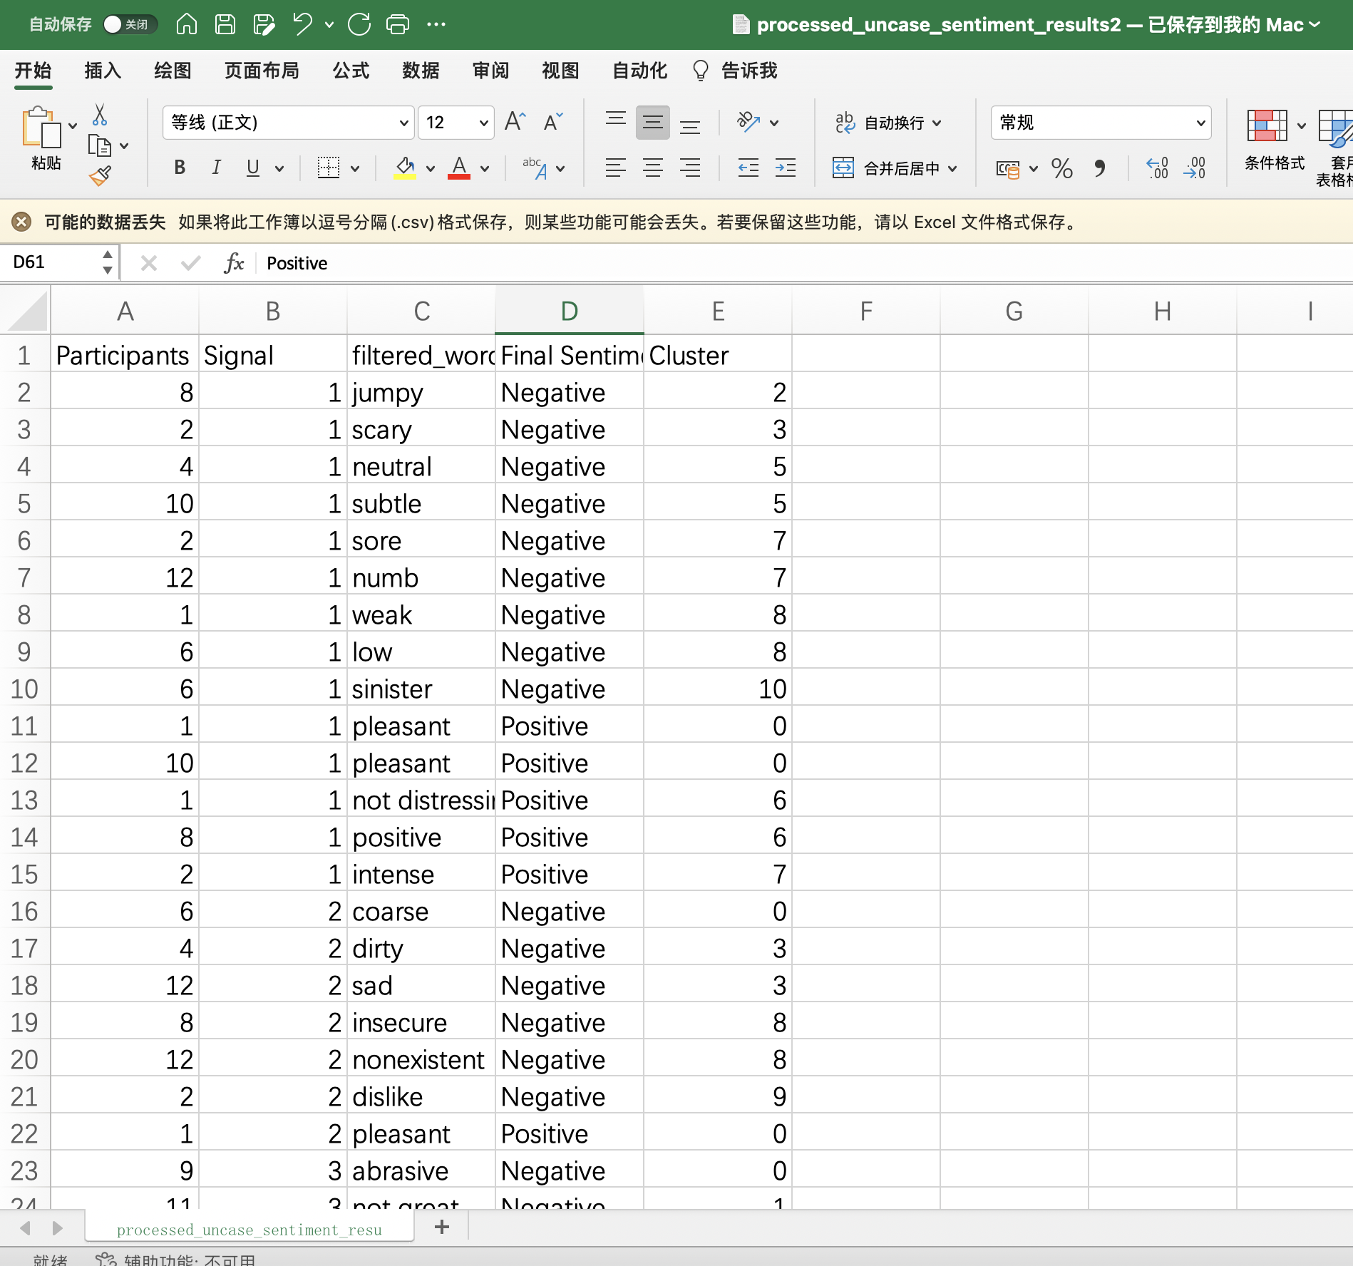

Slide 25
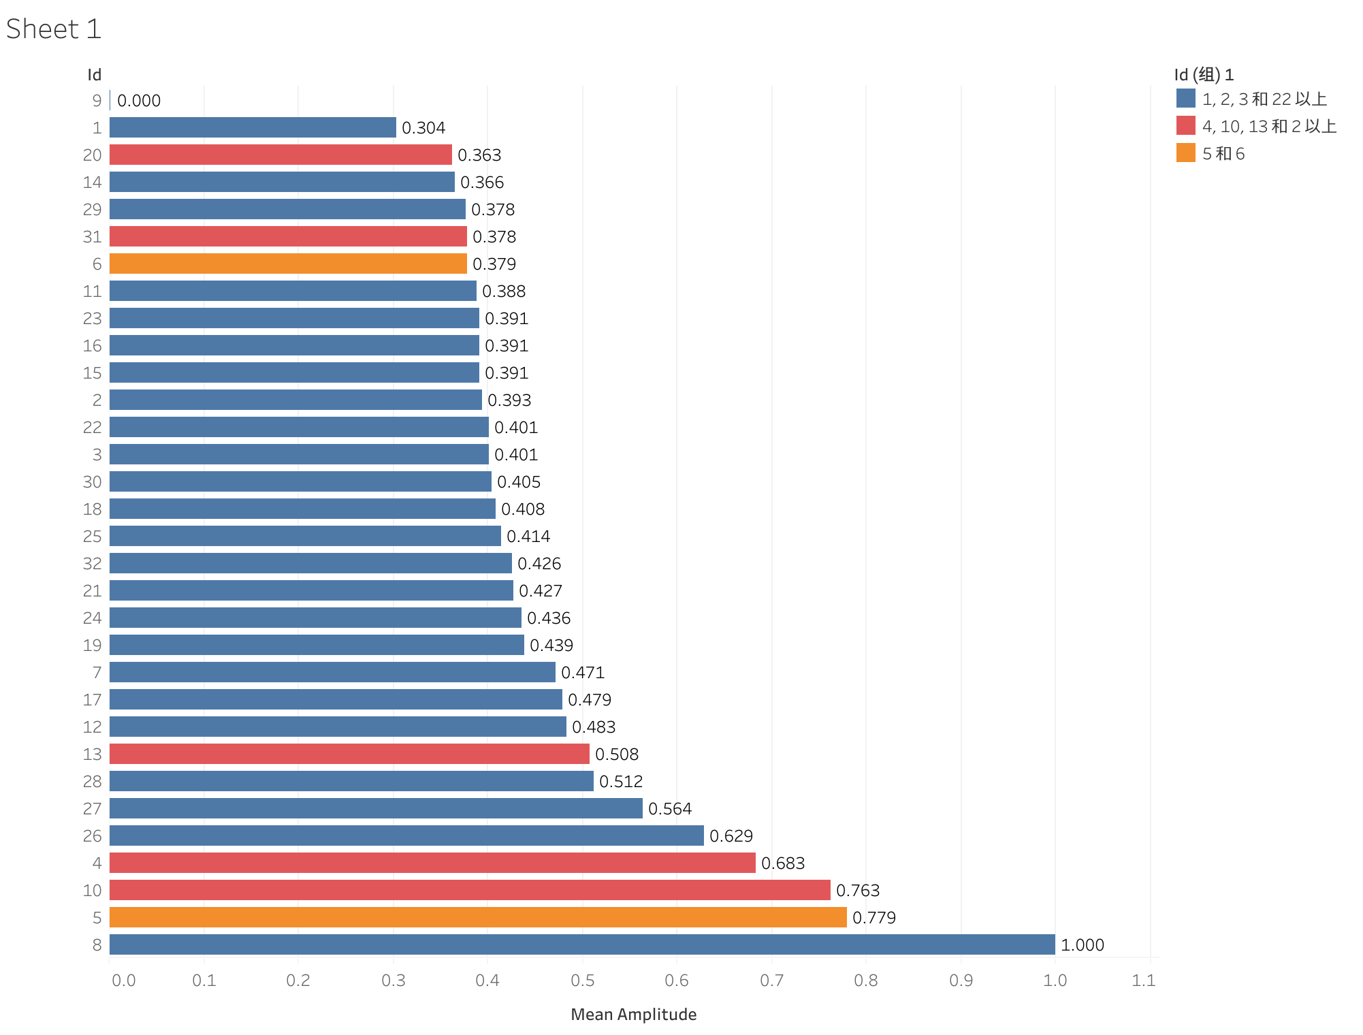
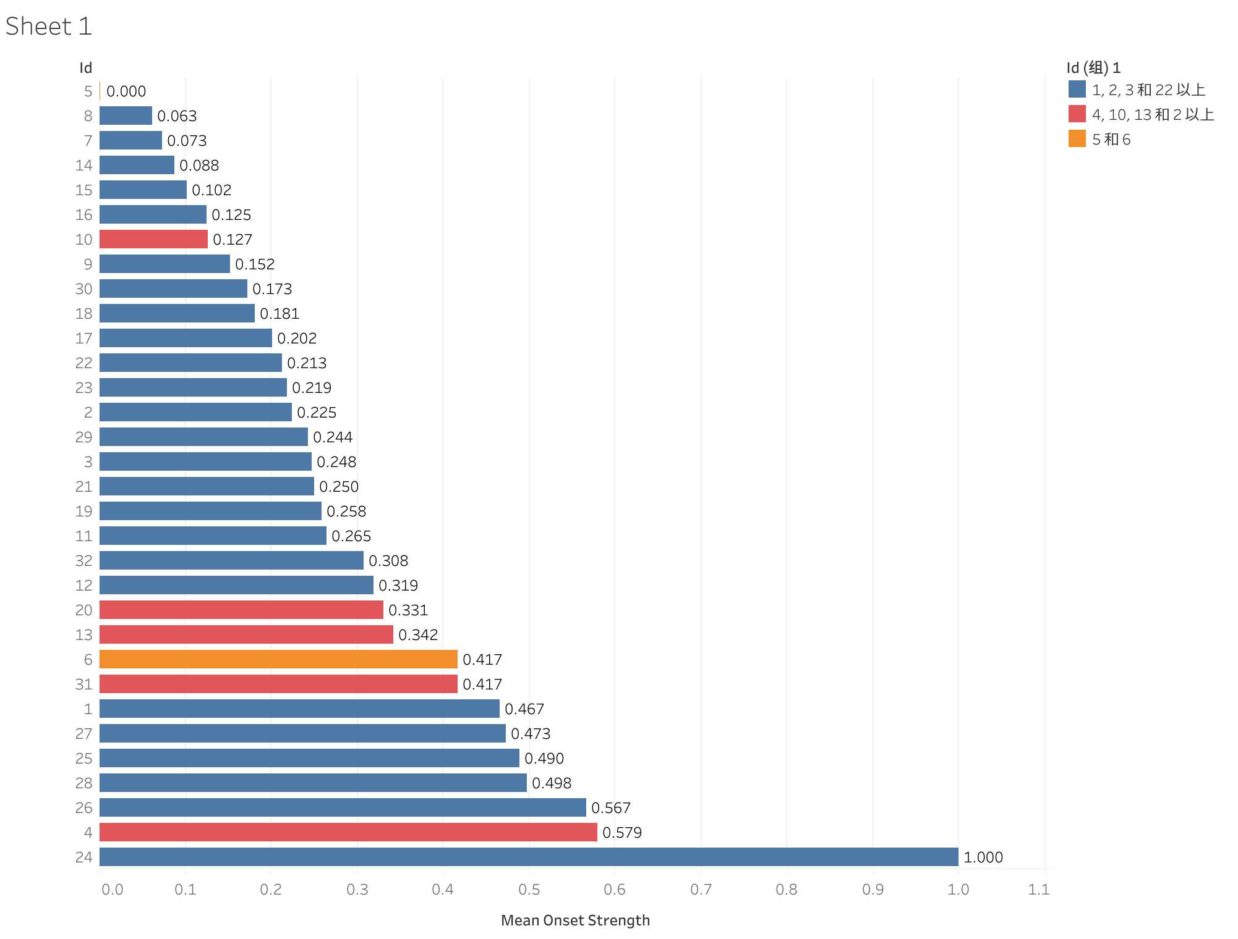
Step 6: Feature visualization according to Ratio of positive and negative

Slide 26
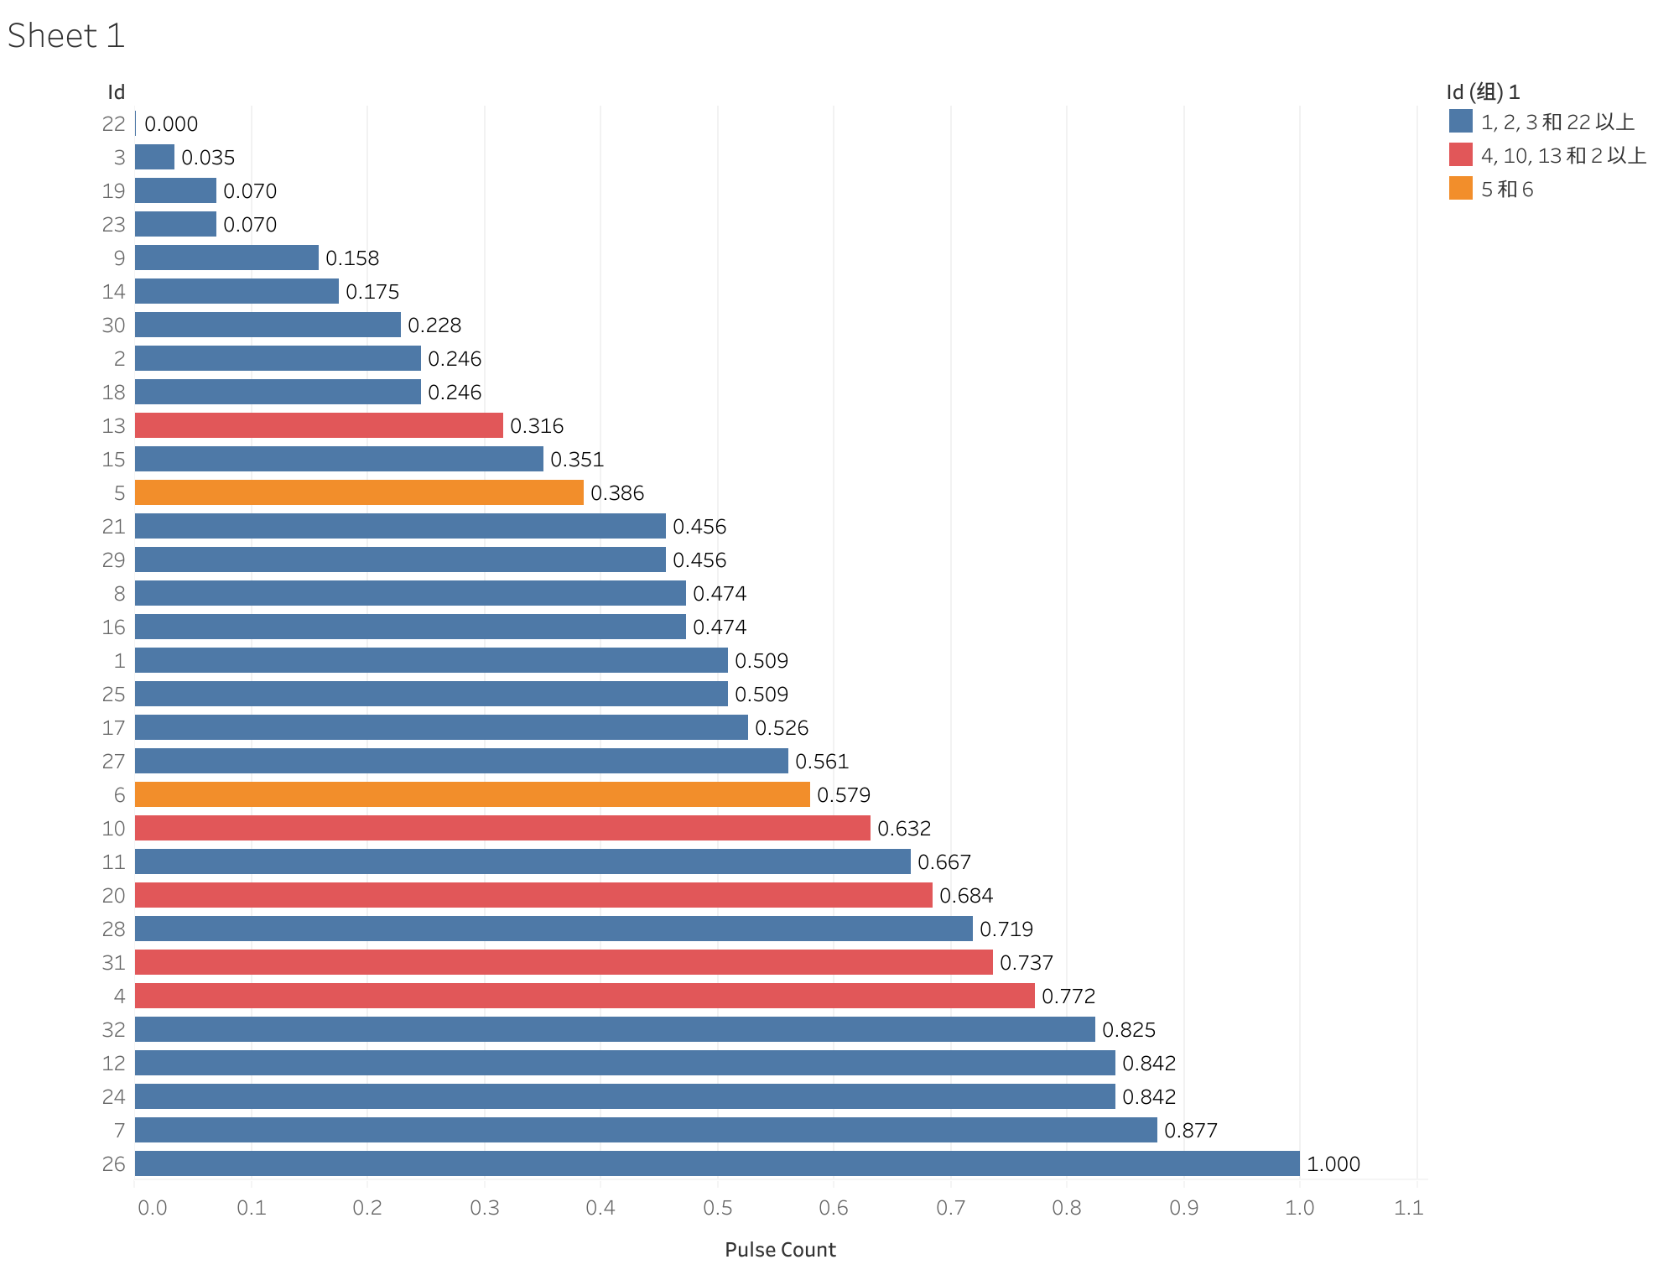
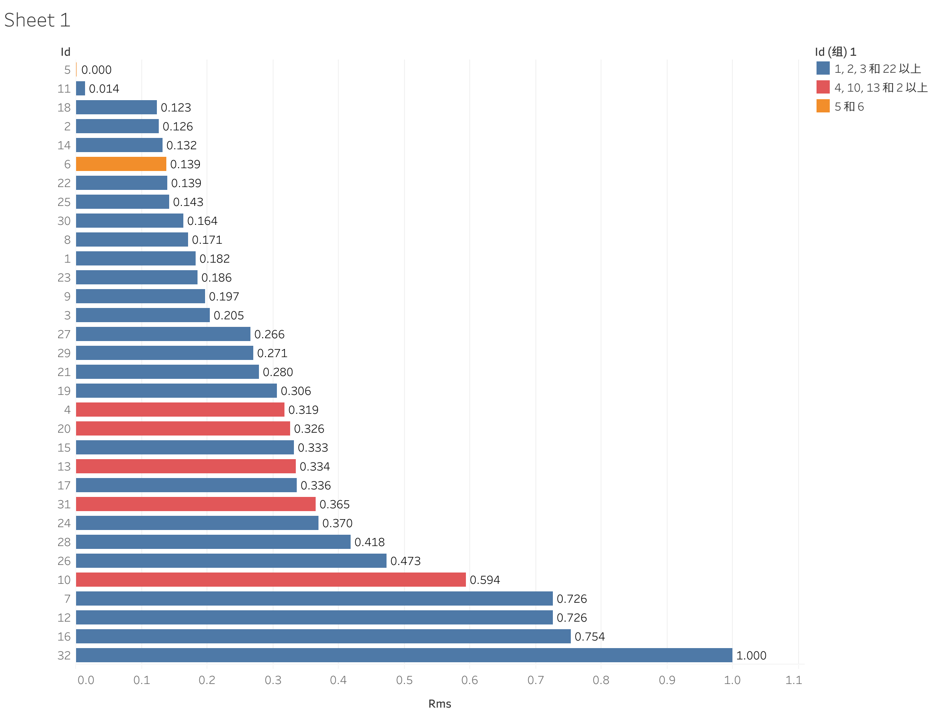
Step 6: Feature visualization according to Ratio of positive and negative

Slide 27
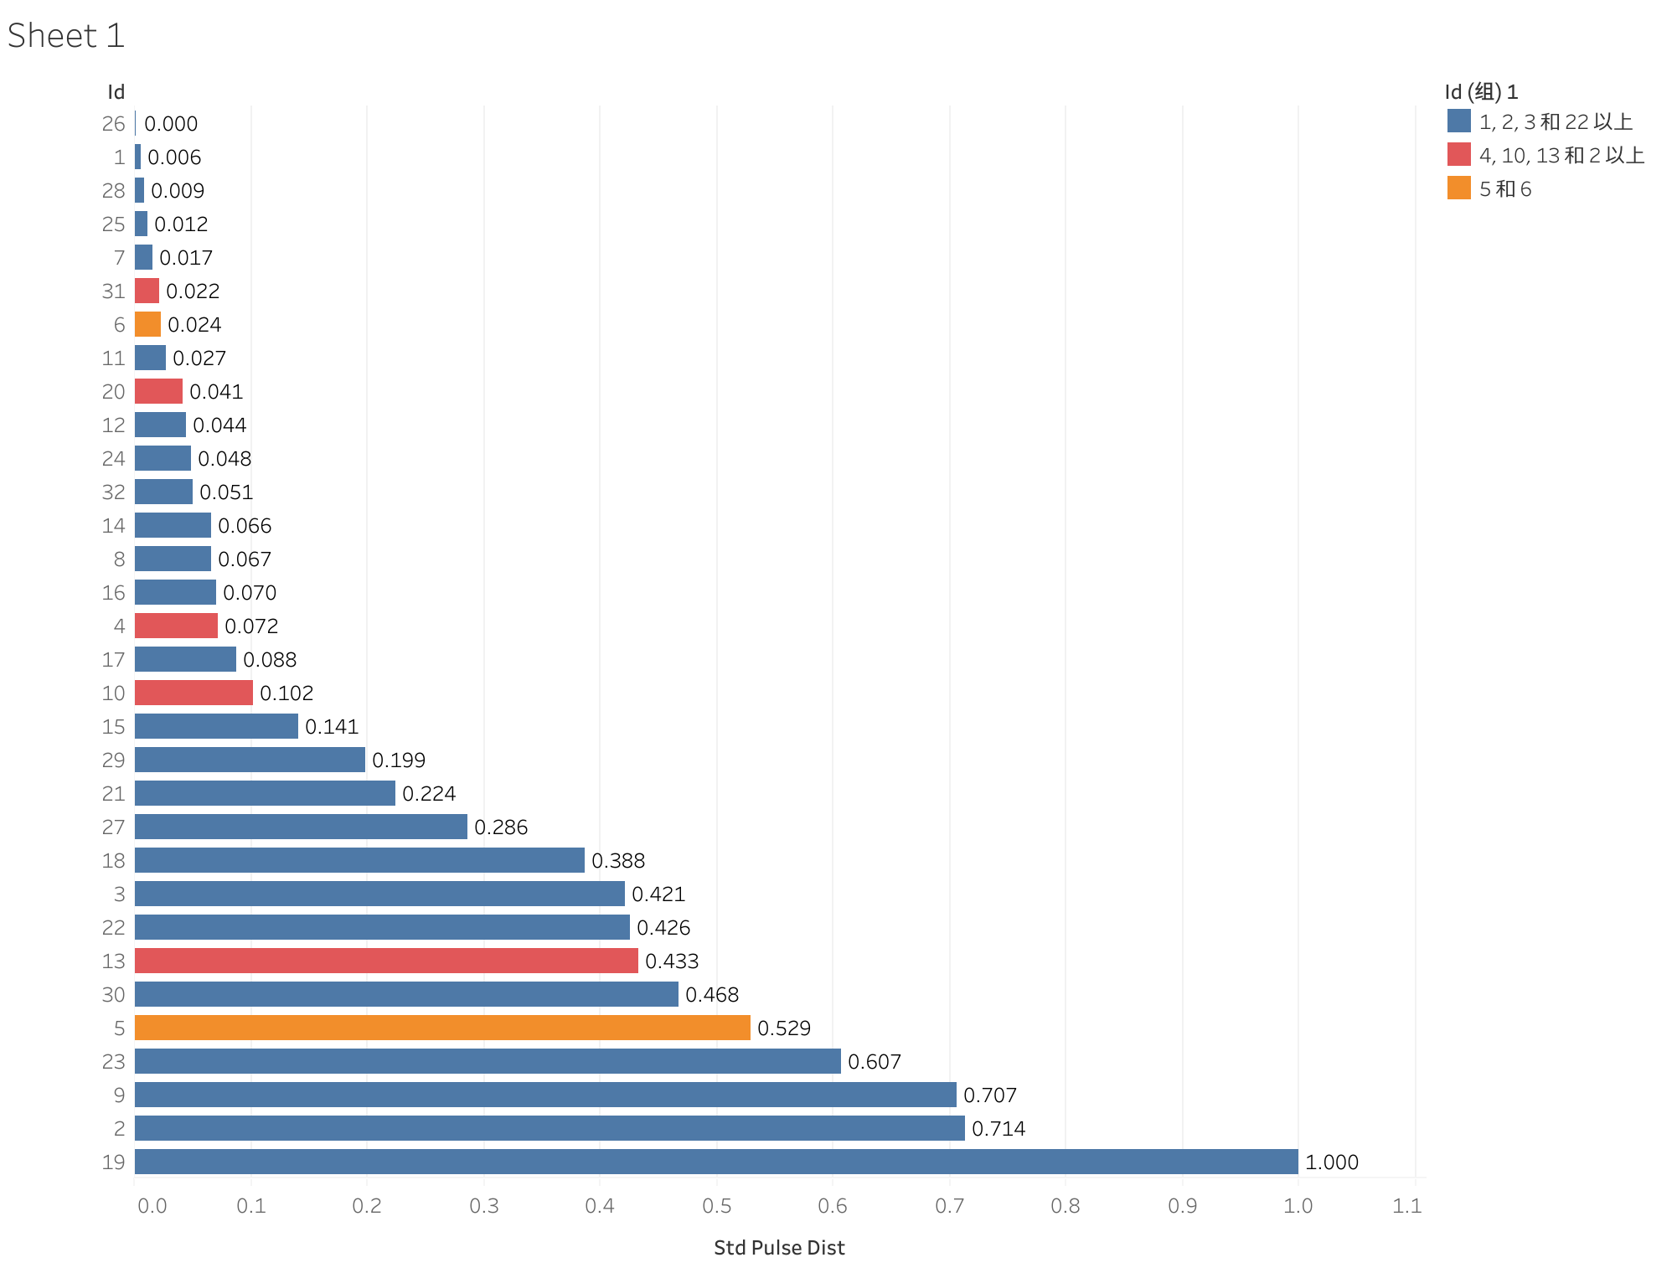
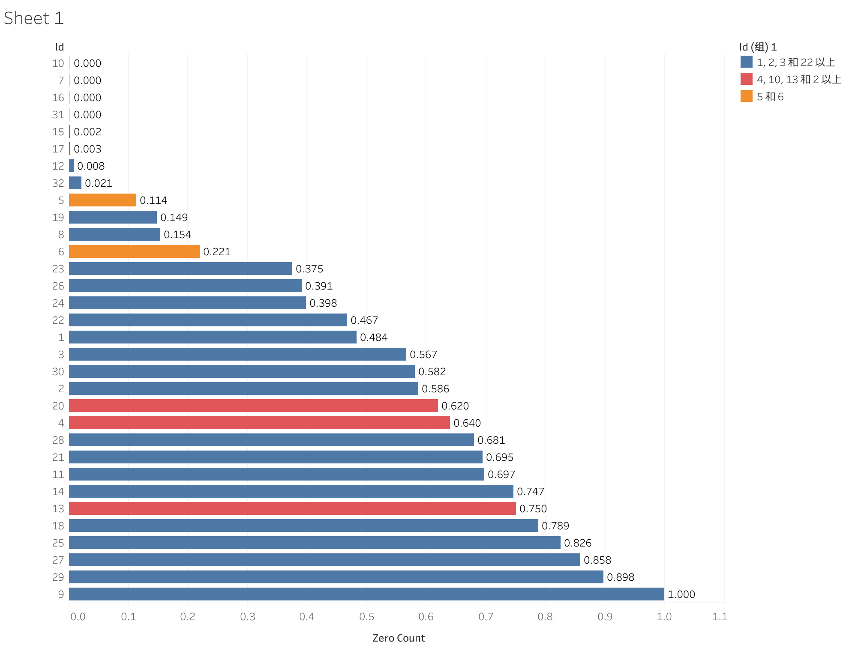
Step 6: Feature visualization according to Ratio of positive and negative

Slide 28
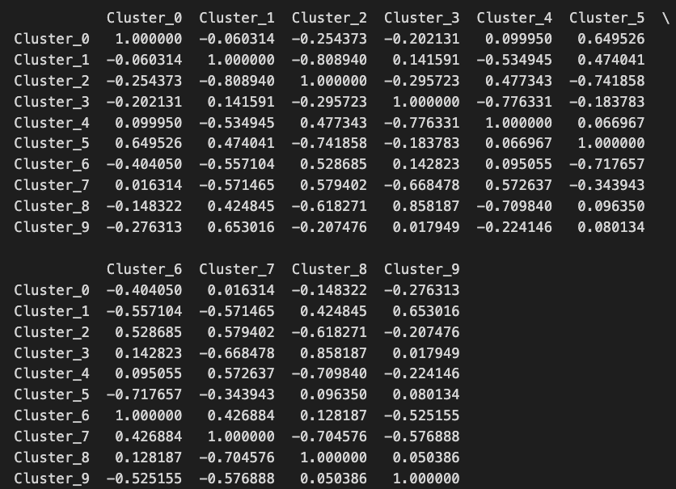
Step 7: The distribution relationship of signal features between different clusters
Cosine similarity

Slide 29
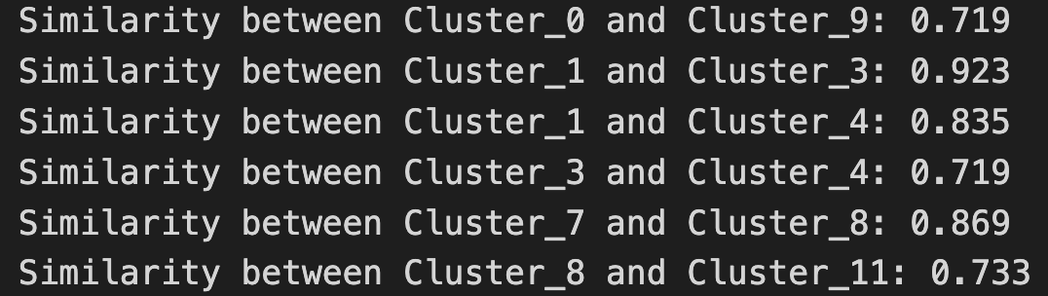
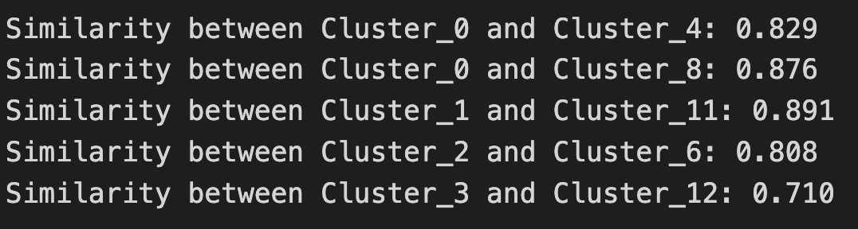
Cosine similarity>=0.7
Glove：
Pos:
Neg:

Slide 30
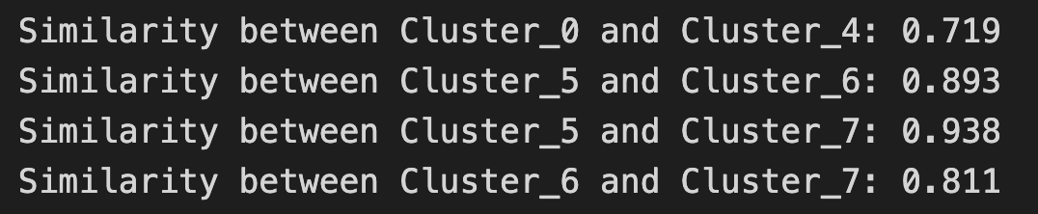
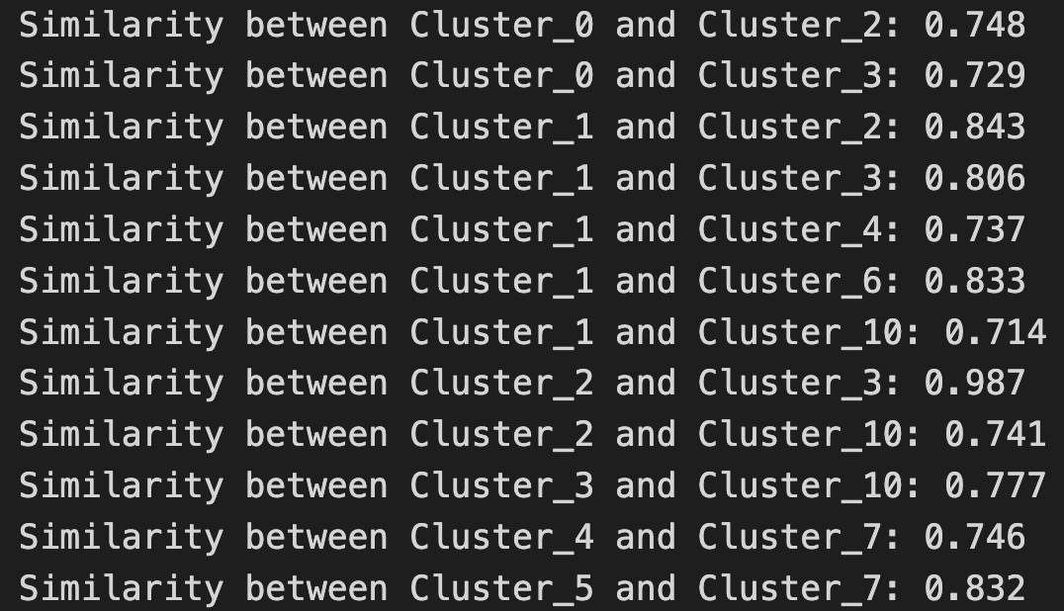
Cosine similarity>=0.7
Word2Vec：
Pos:
Neg:

Slide 31
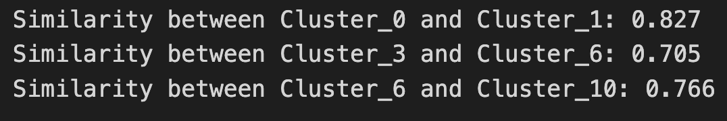
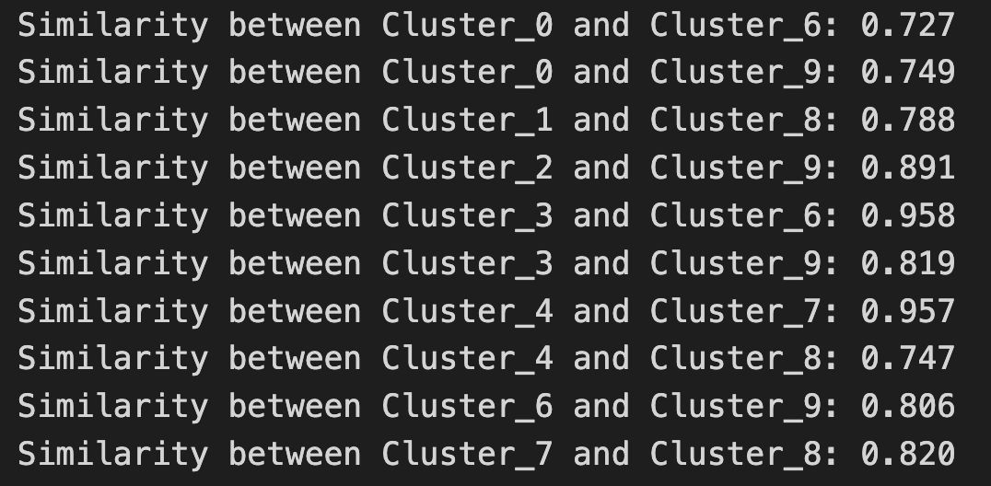
Cosine similarity>=0.7
FastText：
Pos:
Neg:

Slide 32
Next Steps
Find other advanced methods to explore the relationship between signal features and word categories.
Cluster phrases - perhaps Bert can be used.

